Slide 1
2nd Iteration
Client: Fred Sieling
Andres Almaraz and David Luis Hiraldo-Panchana

Slide 2
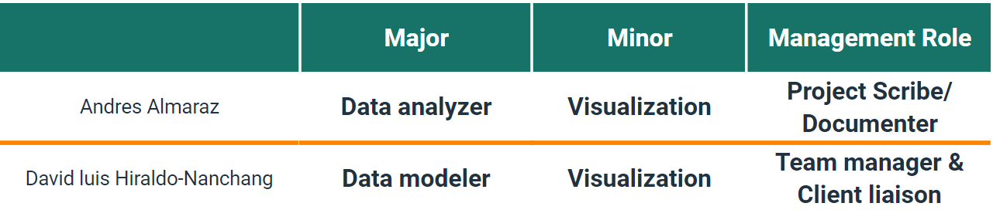
Roles

Slide 3







Technologies

Slide 4
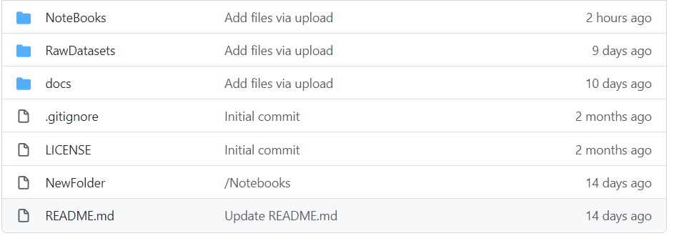
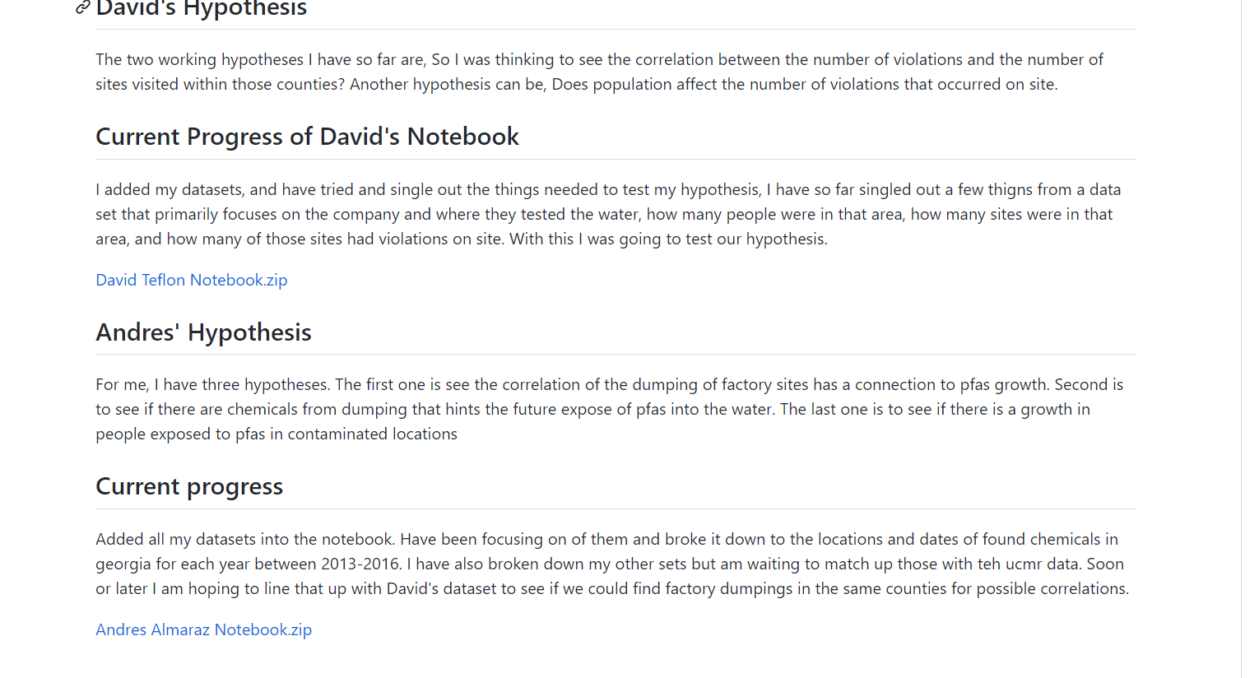
Github repo
The difference between our first iteration github repo to the new repo, is now it is more organized and has a lot more information, we stored our raw datasets, our notebooks and our files, in their respective new folders to keep things more organized. We have also added our hypothesis that we are working on and our current progress in our respective notebooks.

Slide 5
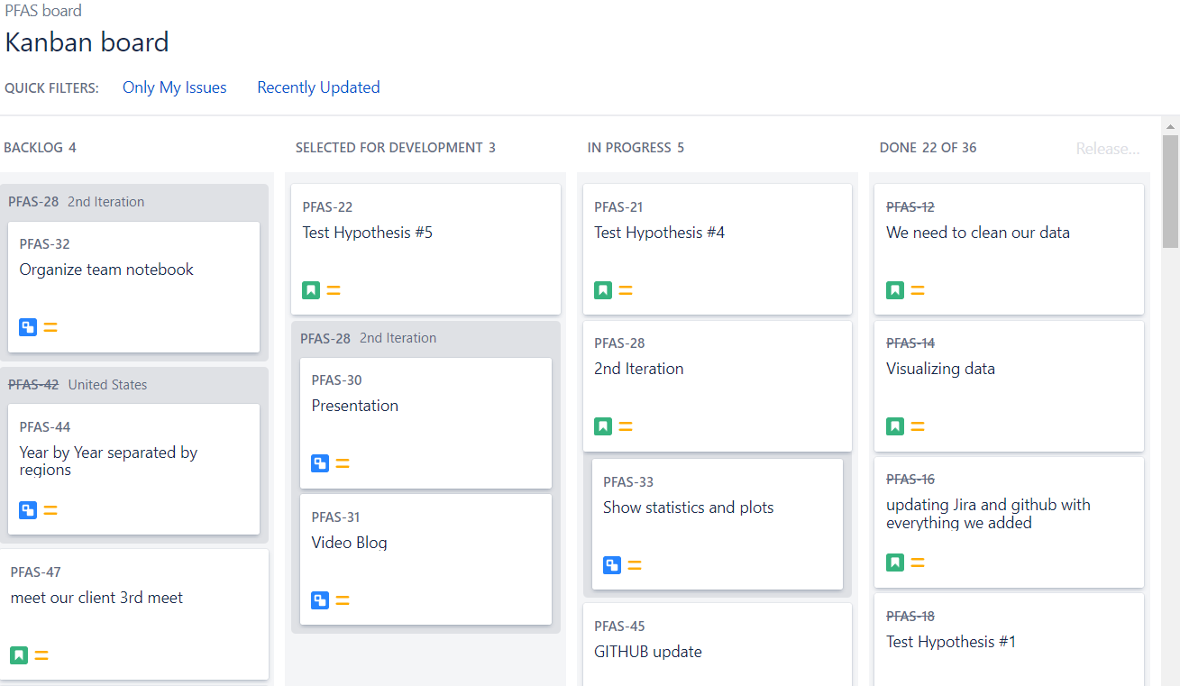
Jira
This is our Jira, this is how we are keeping track of what task we are doing, and how we are coming along, which task are high importance and which task can wait a little before being done, as you can see our 2nd iteration isn’t done until we give you this presentation.

Slide 6
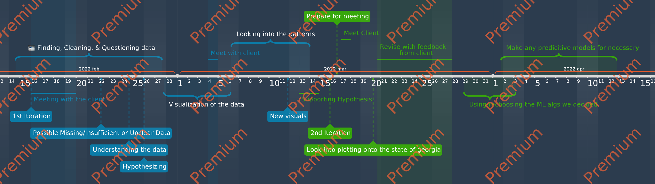
Team Plan
https://time.graphics/line/618637

Slide 7
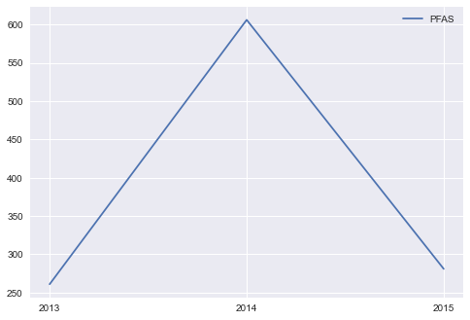
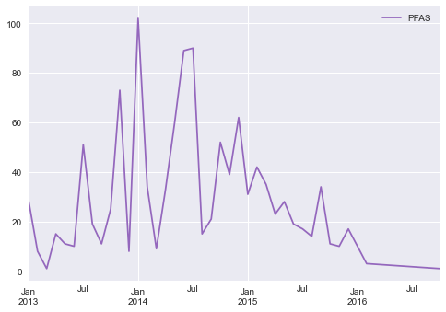
Team Plan
What was done?
We managed to breakdown some data even further so that it could better test the hypotheses
What is missing?
Some visualization could be a lacking
Are we on schedule?
As of this far we are on schedule for the most part and making good pacing
What’s next?
Our next plan on the agenda is to prepare for our meeting with our client and use the feedback he gives us to better improve our project

Slide 8
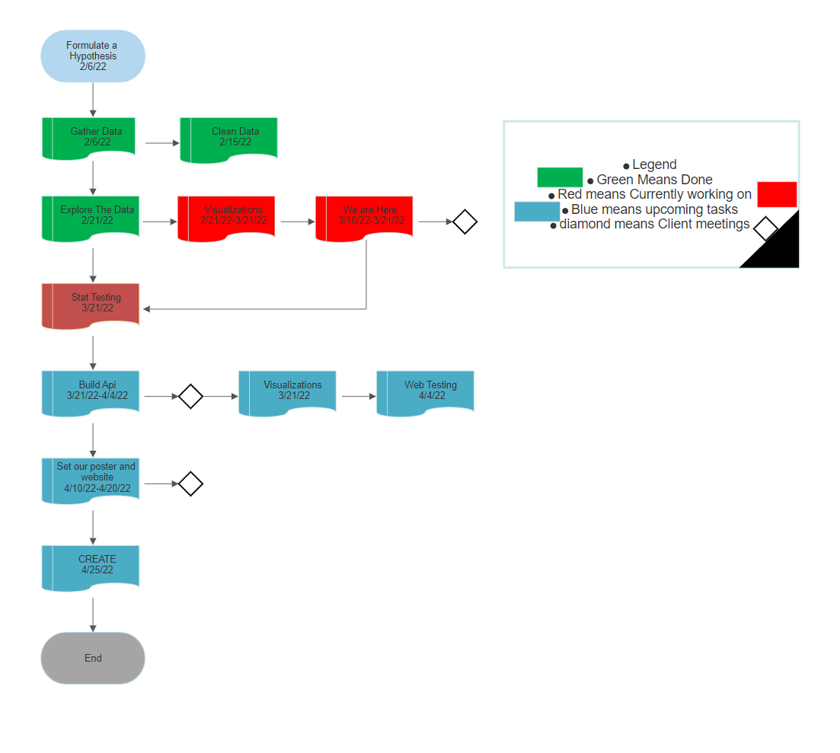
Flow chart of the project
The difference in our flow chart is we are wrapping up our first set of visualizations and starting to move on to statistical testing, as shown as in the image. After our statistical testing we will be moving forward with API testing and the visualizations that will be accompanying it. Then we will begin wrapping up our project by making sure the website is good to go and the poster has all the information we want on it.Just to go over the legend Green means task that have already past and have already been completed, Red means currently working on,Blue means upcoming tasks and the diamond shape is our client meetings.

Slide 9
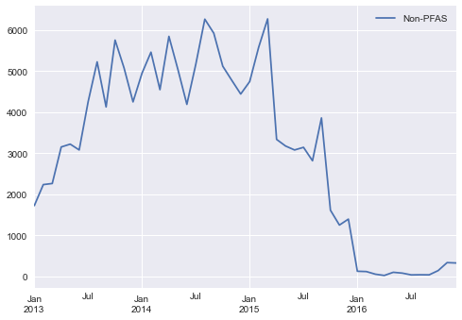
Hypothesis 2
See if there are chemicals from dumping that hints the future expose of pfas into the water

Slide 10
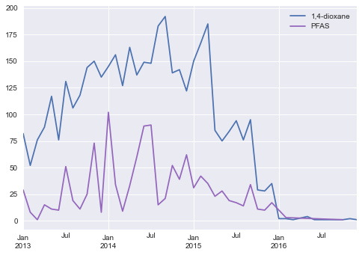
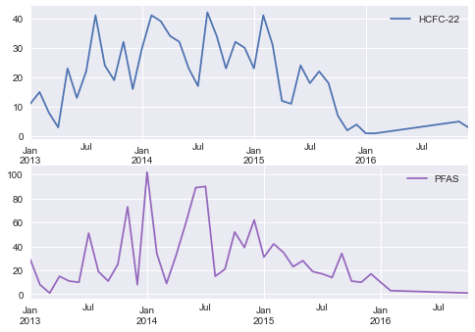
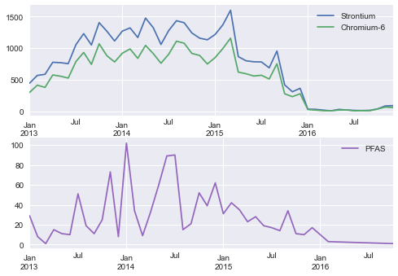
Some Individual Chemicals

Slide 11
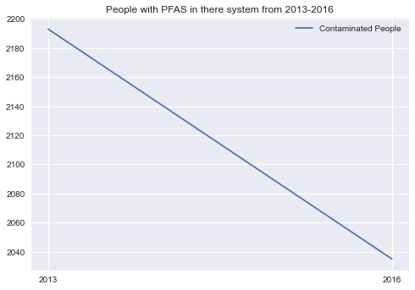
Hypothesis 3
See if there is a growth in people exposed to pfas in contaminated locations

Slide 12
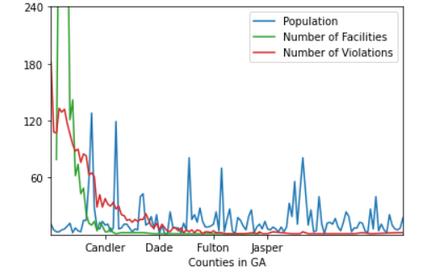
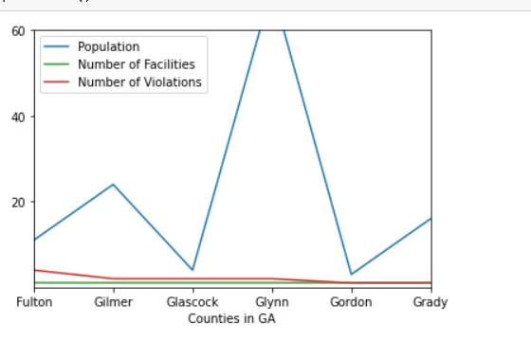
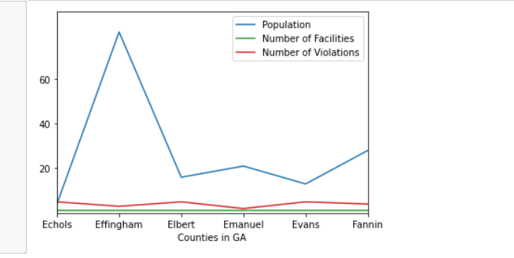
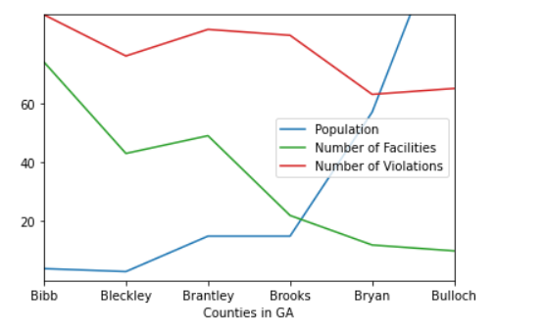
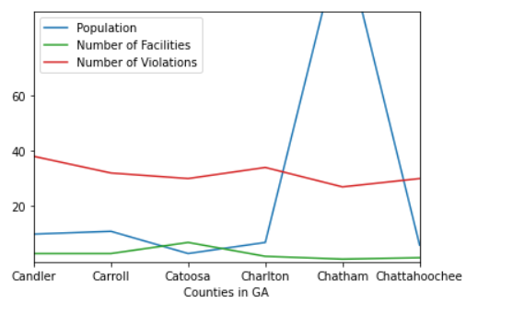
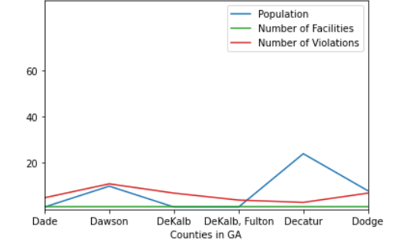
Hypothesis 4
To see if there is a correlation between the number of facilities and the population of each county in GA

Slide 13
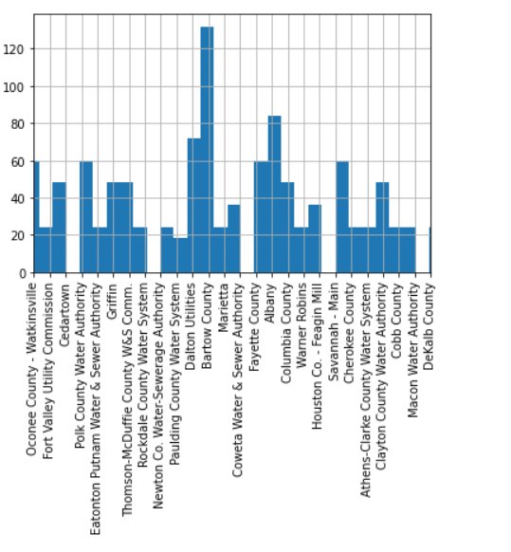
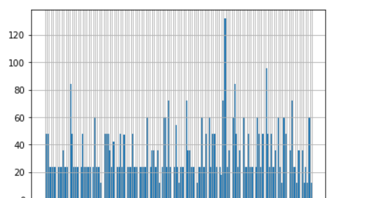
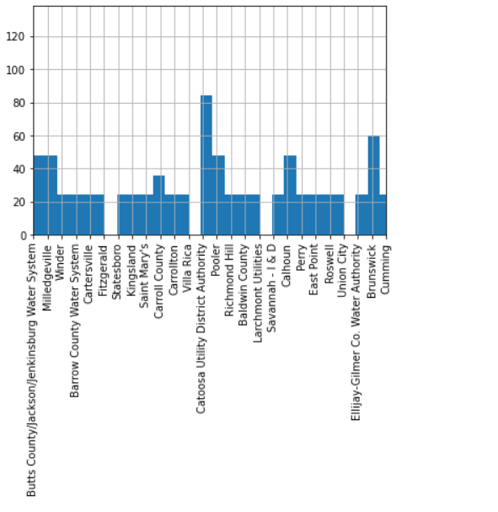
Hypothesis 5
To see where the most traces of pfas occurred within the state of GA

Slide 14
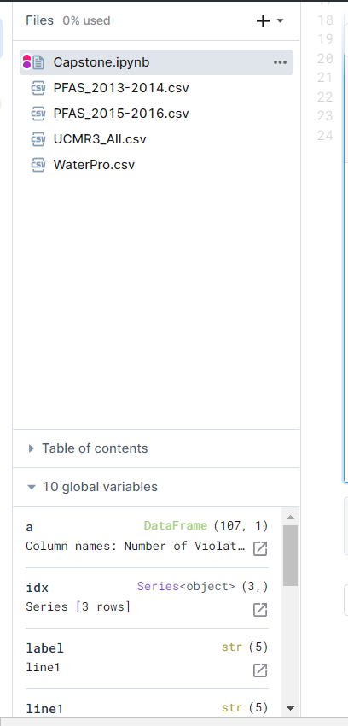
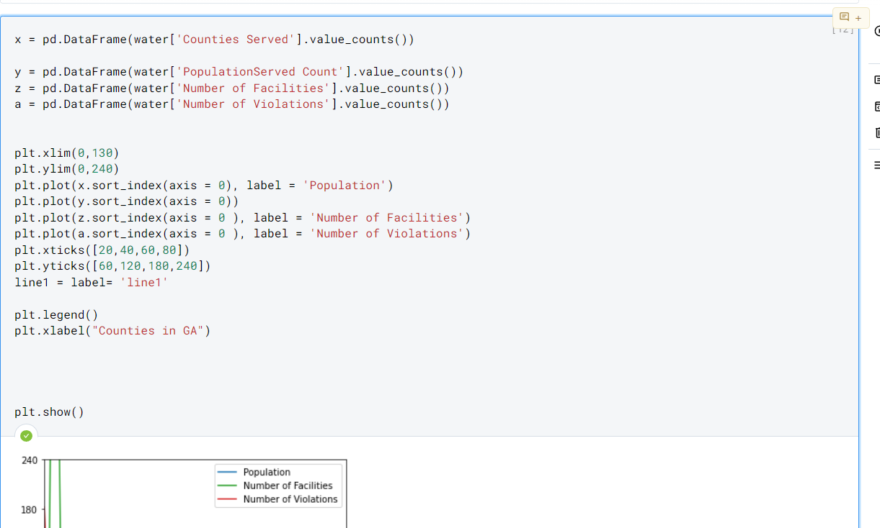
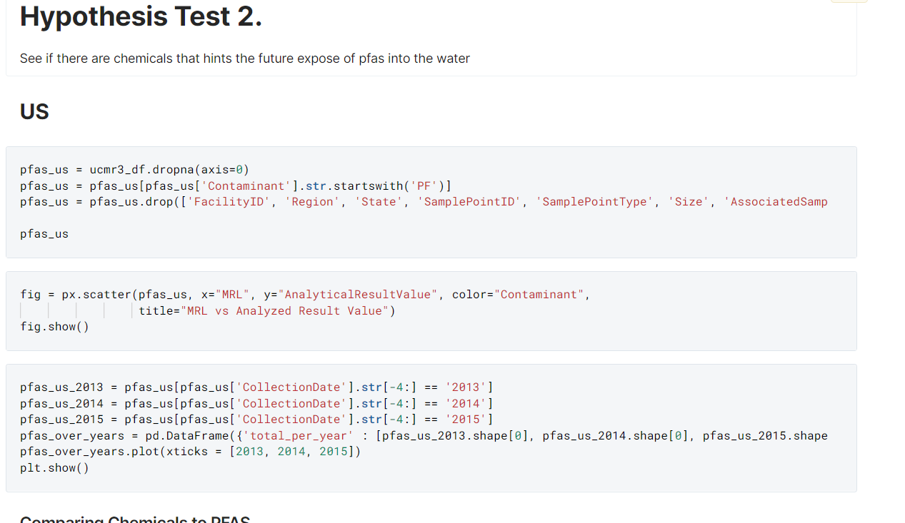
Our Deepnote book together
This is just a brief description of our project in our deepnote together. The top photo shows my work where I look at hypothesis test 4, seeing if population has any correlation with one of those categories listed. The bottom shows Andres work being hypothesis 2.

